Slide 1
SCOBA 3.1

Slide 2
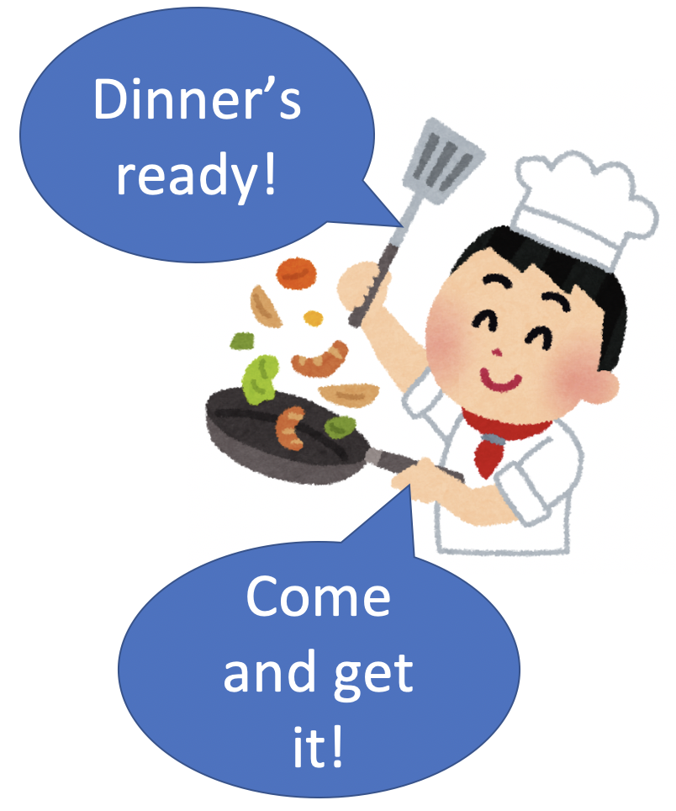

Slide 3
A:gohan-ga dekita yo B: hai, ima iku!

Slide 4
Iku: speaker moves away from speaker’s current location

Slide 5
SCOBA 3.2

Slide 6
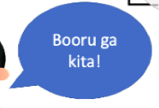
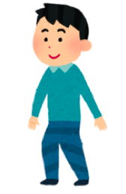

Slide 7
kuru: item moves toward the speaker

Slide 8
SCOBA 4

Slide 9
on your birthday Your friend: omedetoo! You : ohana, kureru no? arigatoo!

Slide 10
Kureru: direction of giving: toward me and mine (in-group)

Slide 11
SCOBA 4 continues

Slide 12
on your friend’s birthday You : omedetoo , ichigo-choko ageru. Your friend: arigatoo!

Slide 13
Ageru: direction of giving: away from me and mine (in-group)

